Slide 1


Computational and Experimental Design Single Cell Analysis Program (SCAP) Workshop
September 23-27, 2024
Kilifi, Kenya

Slide 2
Computational track
Monday
Module 1 - pre-processing
Module 2 - quality control, normalization
Project time
Tuesday
Module 3 - cell subsets, differential expression, cell annotation
Module 4 - batch correction, integration
Project time
Wednesday
Module 5 – immune repertoires
Project time
Thursday
Project time
Friday
Project presentations

Slide 3
Module 1 - pre-processing
1a. Going from raw sequencing files to gene count matrices.
1b. Terra cloud computing for pre-processing 10x genomics data

Slide 4
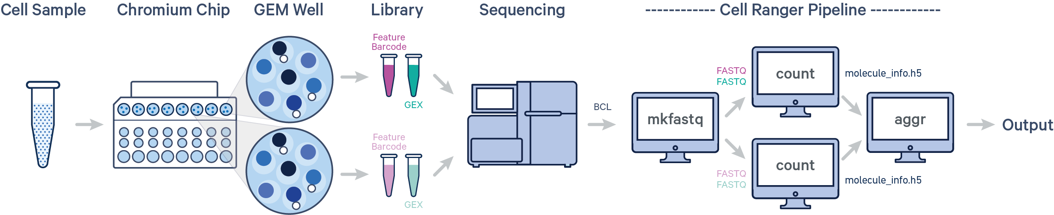
Raw sequencing files to gene count matrices
Source: 10X Genomics

Slide 5
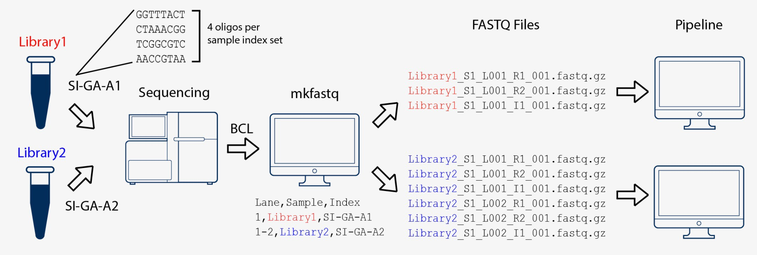
Raw sequencing files to count matrices
Step 1: BCL to FASTQ
The primary output of Illumina sequencing instruments are per-cycle base call files in BCL format.
The first step is to convert these BCL files to fastq files. Steps include separating reads into individual fastq files based on their barcode (demultiplexing) and moving unique molecular identifier (UMI) bases from the read to the fastq header.
Tools: cellranger mkfastq, bcl2fastq or BCL Convert
Source: 10X Genomics

Slide 6
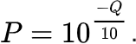
Raw sequencing files to count matrices
Step 1: BCL to FASTQ
A FASTQ file is a text file that contains the sequence data which consists of:
A sequence identifier with information about the sequencing run and the cluster.
The sequence (the base calls; A, C, T, G and N).
A separator, which is simply a plus (+) sign.
The base call quality scores as phred scores
Example sequence in a FASTQ
@HWI-ST808:130:H0B8YADXX:1:1101:2088:2222:CELL_GGTCCA:UMI_CCCT AGGAAGATGGAGGAGAGAAGGCGGTGAAAGAGACCTGTAAAAAGCCACCGN
+ @@@DDBD>=AFCF+<CAFHDECII:DGGGHGIGGIIIEHGIIIGIIDHII#

Slide 7
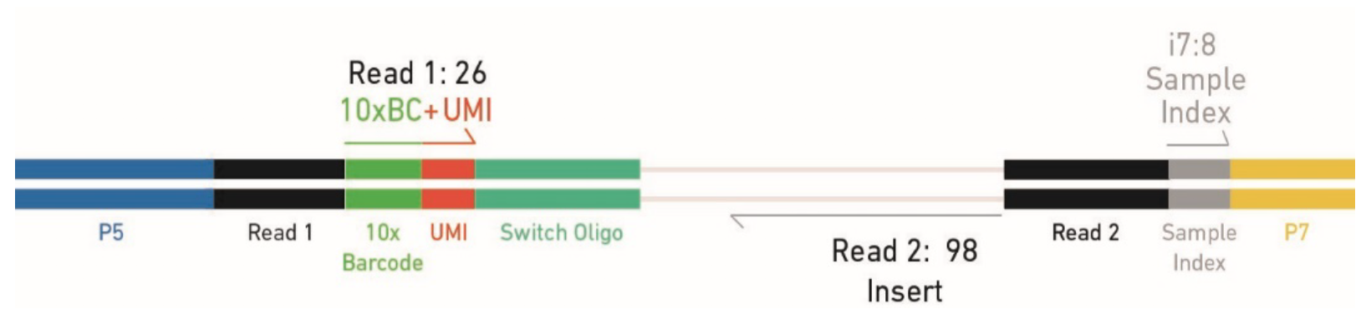
Raw sequencing files to count matrices
Step 1: BCL to FASTQ
Each fastq file generated by bcl2fastq contains different information:
I1.fastq contains sample index (for pooling together multiple samples)
R1.fastq contains cell barcode + UMI
R2.fatsq contains transcript information
R1.fastq
R2.fastq
I1.fastq

Slide 8
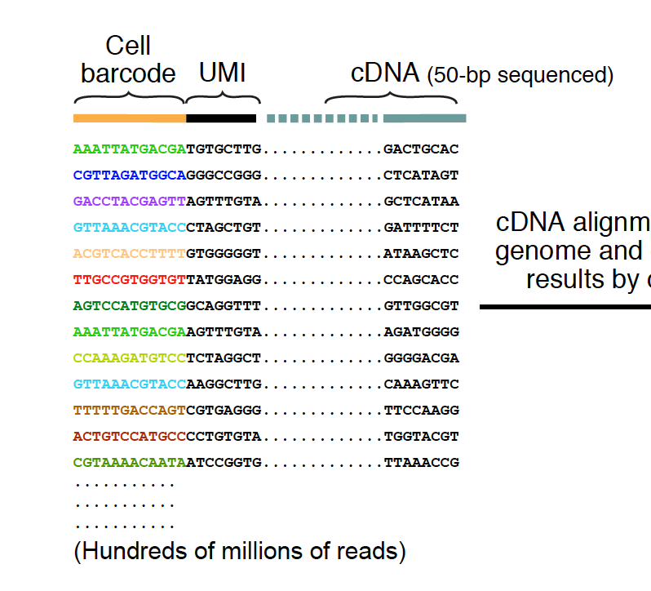
Raw sequencing files to count matrices
Step 1: BCL to FASTQ
An example of what the reads look like…
R1.fastq
R2.fastq

Slide 9
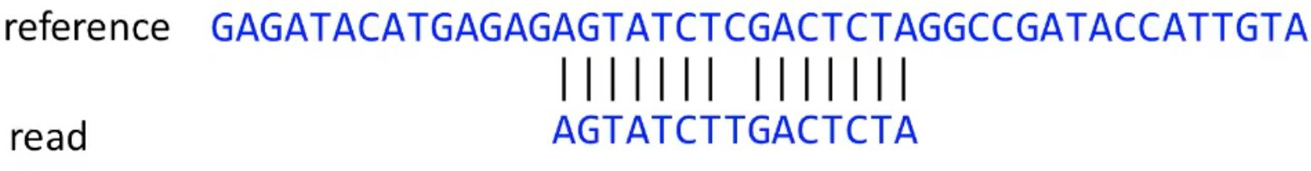
Raw sequencing files to count matrices
Step 2: Alignment to reference genome
The next step is to determine which gene each read originated from. In order to do this the read sequences are mapped to a precompiled genome reference.
Be mindful of reference versions and sources. Use the latest reference when possible.
Human reference, GRCh38 (GENCODE v32/Ensembl 98)
Mouse reference, mm10 (GENCODE vM23/Ensembl 98)

Slide 10
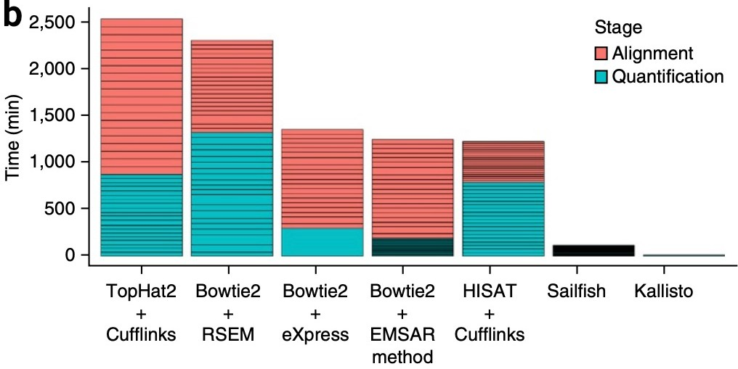
Raw sequencing files to count matrices
Step 2: Alignment to reference genome
The choice of aligner is often a personal preference and also dependent on the computational resources that are available to you.
https://hbctraining.github.io

Slide 11
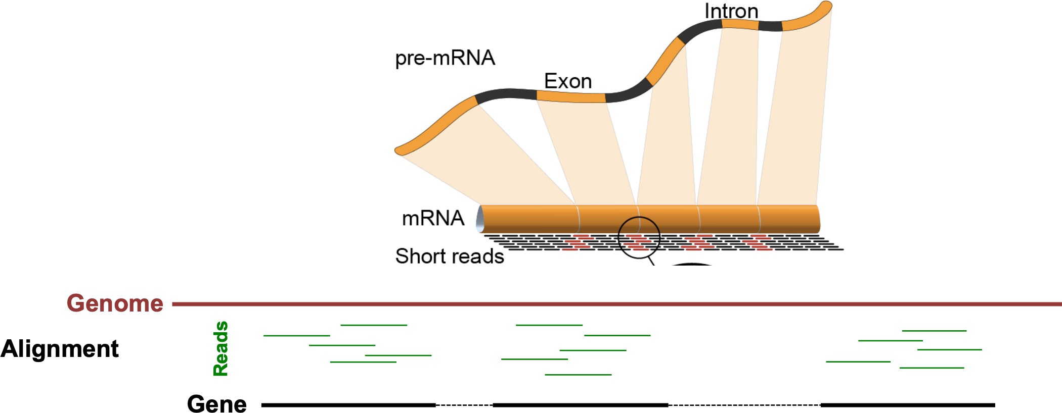
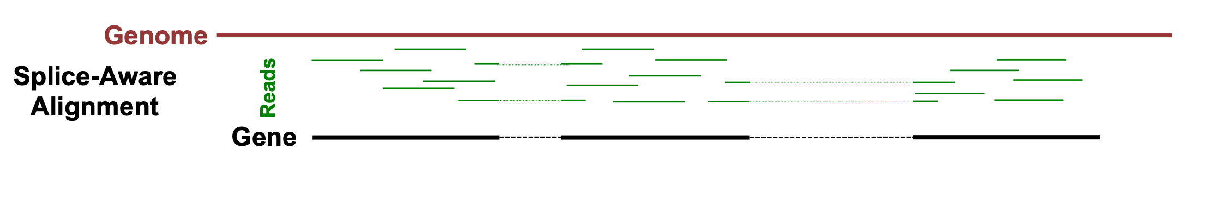
Raw sequencing files to count matrices
Step 2: Alignment to reference genome
10X Cellranger uses the STAR aligner.
Because of widespread splicing in animal genomes, read alignment against a genome should be done with a splice-aware aligner.
https://hbctraining.github.io

Slide 12
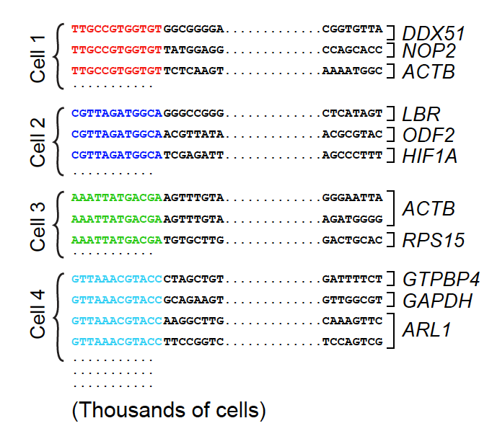
Raw sequencing files to count matrices
Step 3: Counting reads
Reads that have been confidently mapped to the transcriptome are then assigned to cells based on their barcode (cell barcode demultiplexing) and the the number of unique RNA molecules corresponding to each gene within each cell are counted (UMI deduplication).

Slide 13
Raw sequencing files to count matrices
Step 3: Counting reads
Reads that have been confidently mapped to the transcriptome are then assigned to cells based on their barcode (cell barcode demultiplexing) and the the number of unique RNA molecules corresponding to each gene within each cell are counted (UMI deduplication).
The result is the gene x cell matrix that is the starting point for downstream analysis.

Slide 14
Module 1 - pre-processing
1a. Going from raw sequencing files to gene count matrices.
1b. Terra cloud computing for pre-processing 10x genomics data

Slide 15

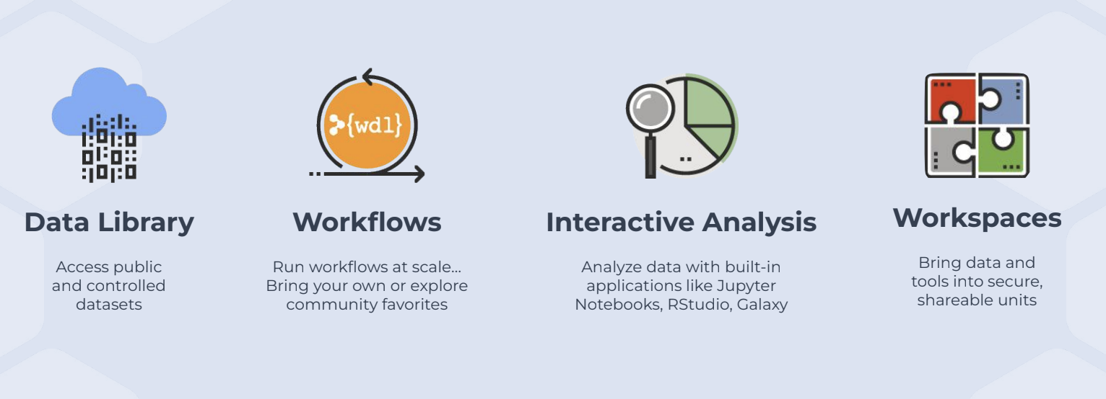
Terra is a cloud computing service for data analysis
Derek Caetano-Anolles

Slide 16
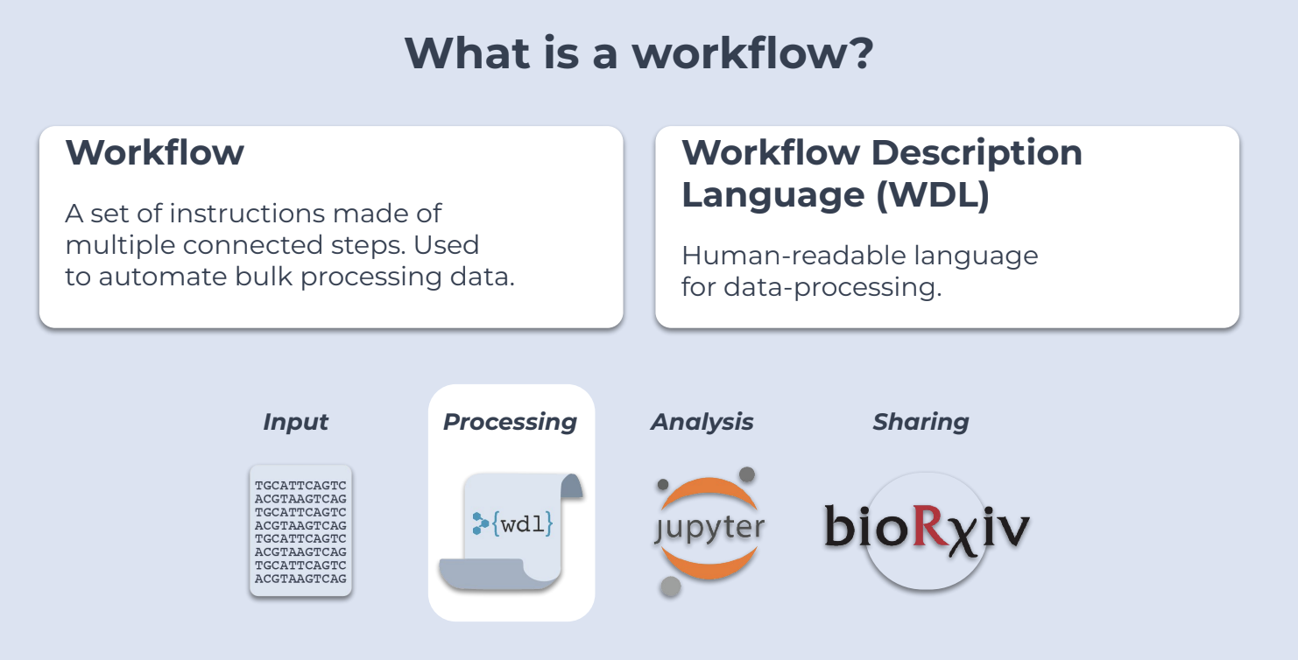
Terra workflows
Derek Caetano-Anolles

Slide 17
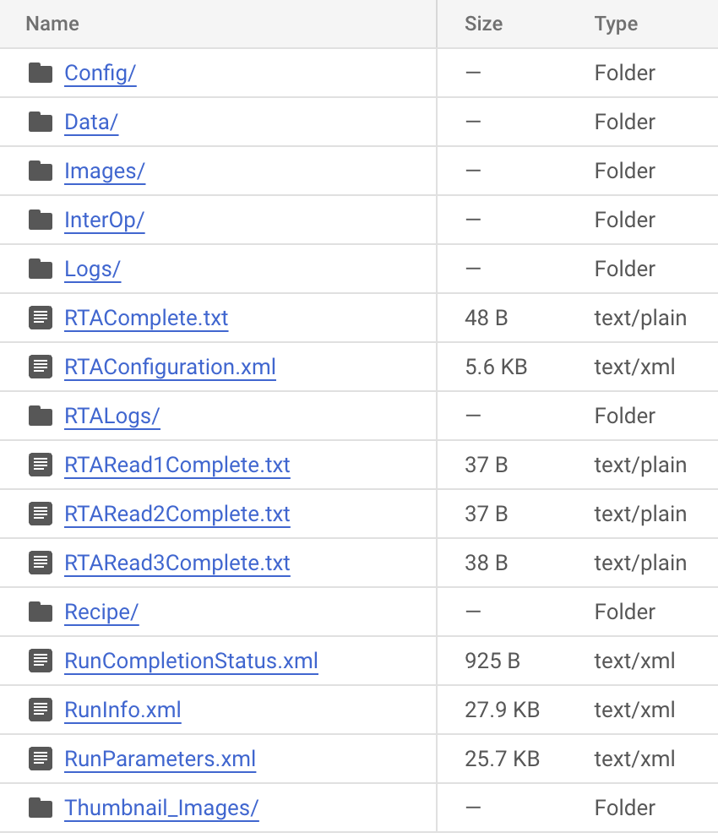
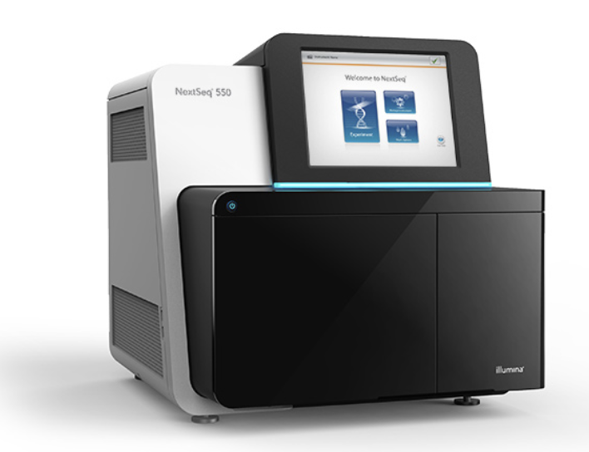
Starting point for pre-processing: Illumina sequencer output files

Slide 18
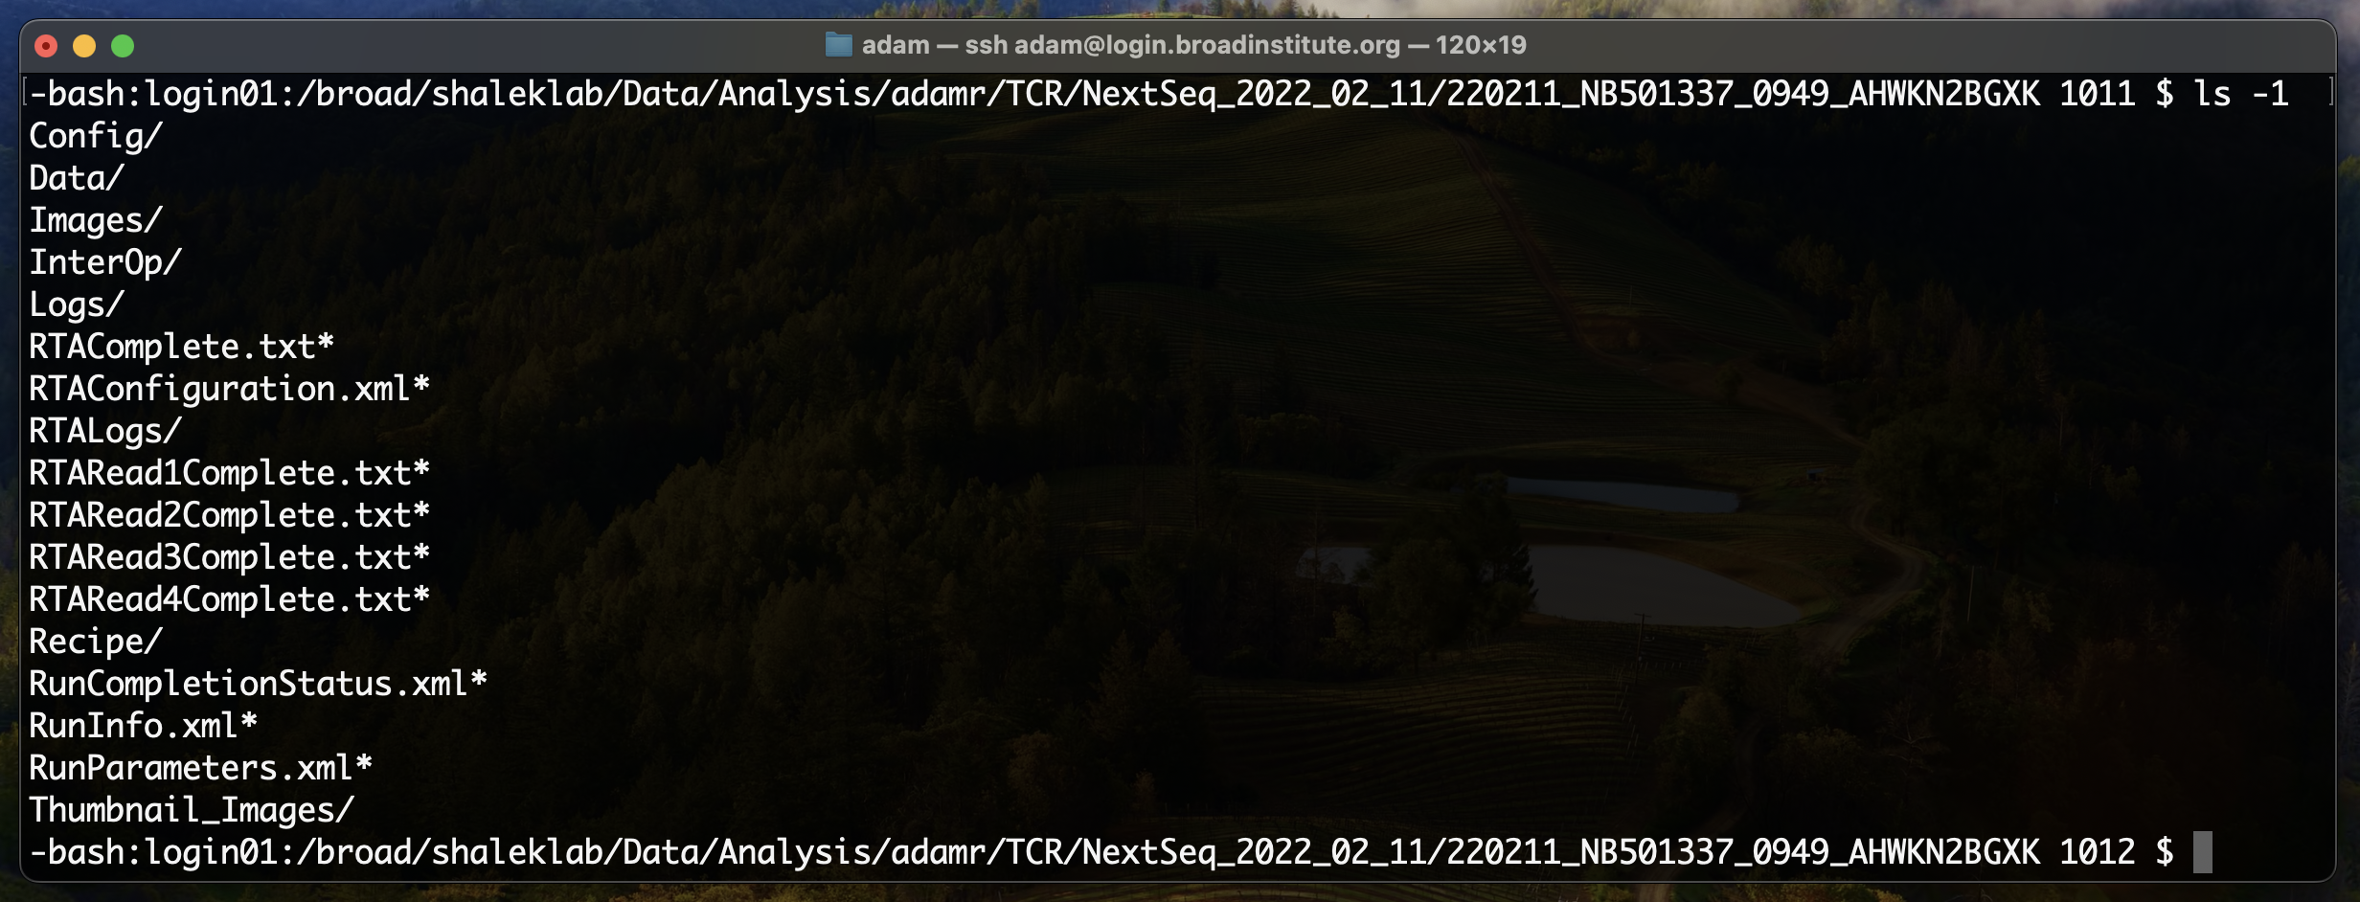
Starting point for pre-processing: Illumina sequencer output files

Slide 19
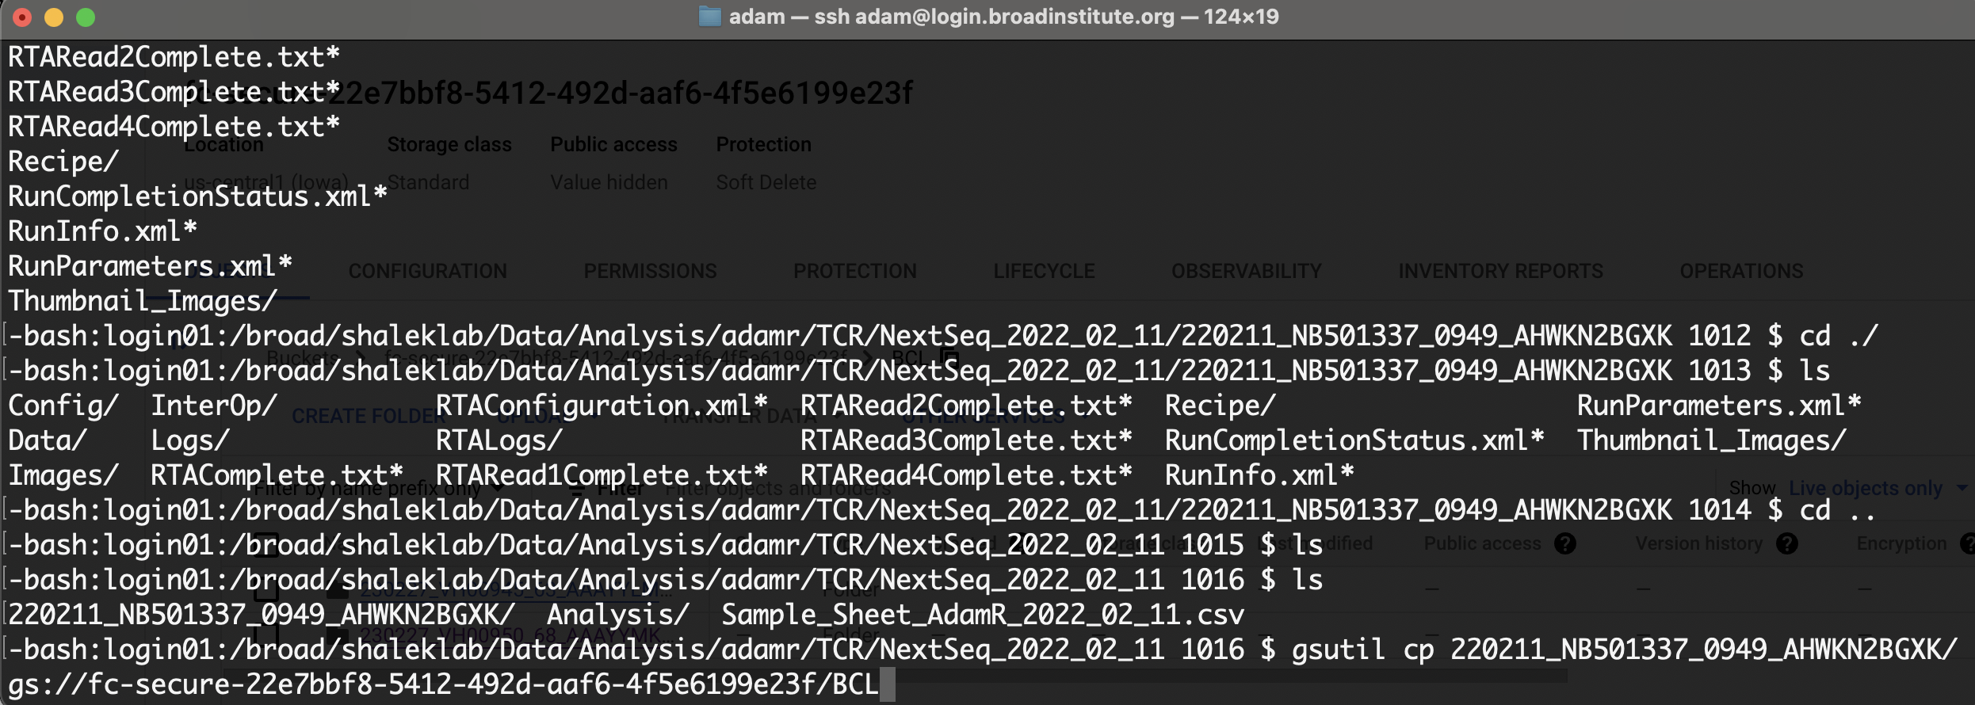
Next step: transfer Illumina data to the cloud
Use gsutils from Google Cloud SDK to transfer Illumina output data to Terra

Slide 20
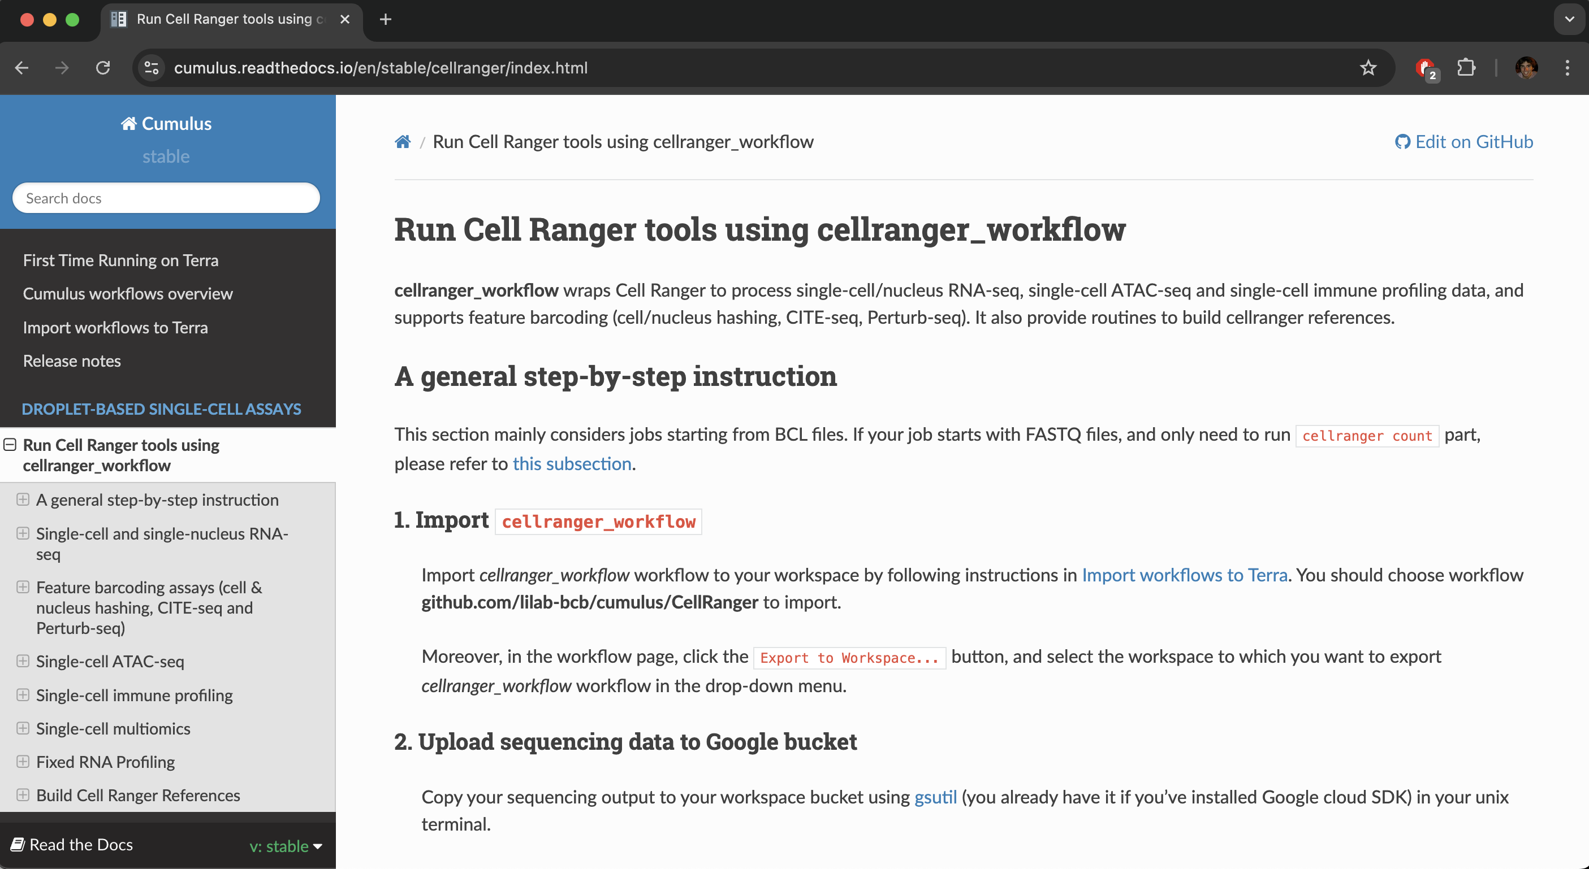
Cumulus is a set of tools that run genomics workflows including 10x Cell Ranger
https://cumulus.readthedocs.io/en/stable/cellranger/index.html

Slide 21
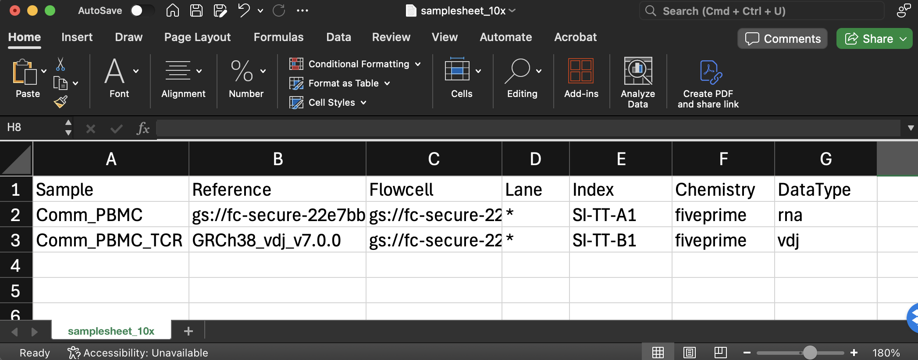
Make Cumulus sample sheet
Make sample sheet file to direct Cell Ranger to input files and provide sample details

Slide 22
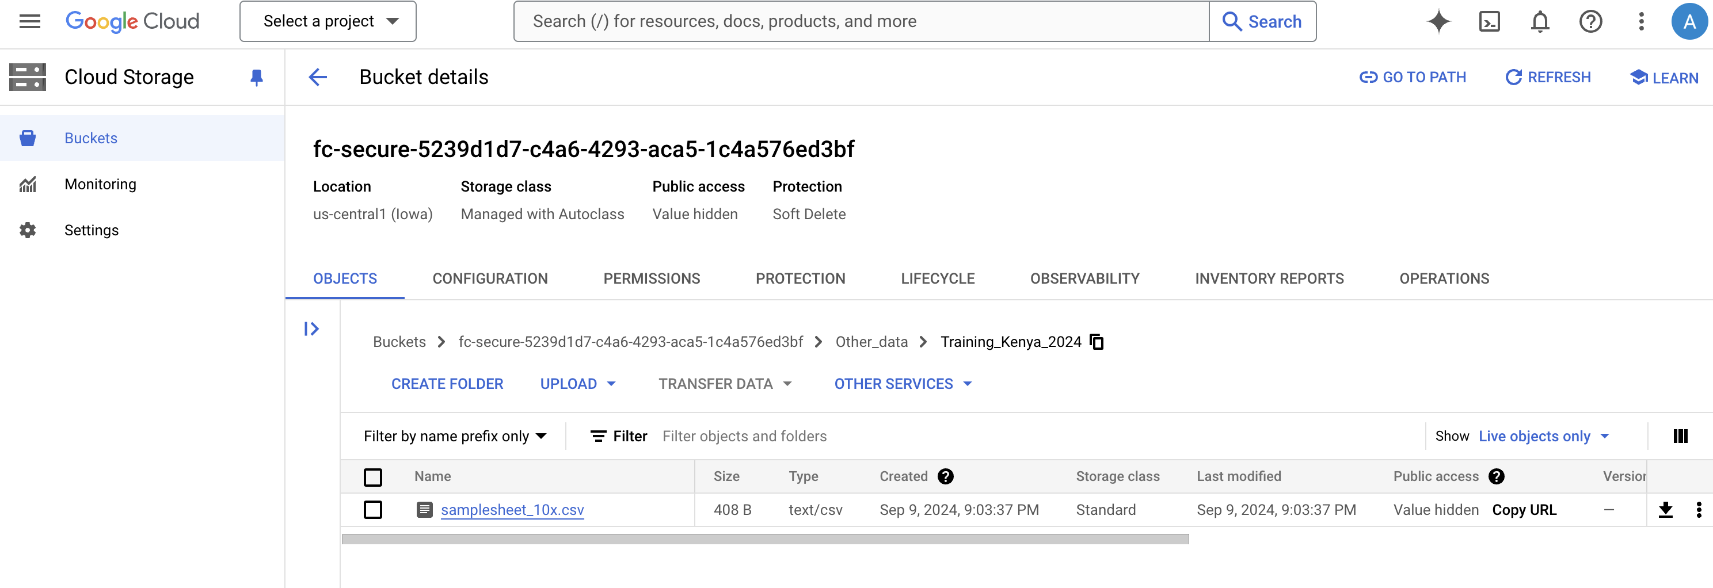
Upload sample sheet file to Google bucket

Slide 23
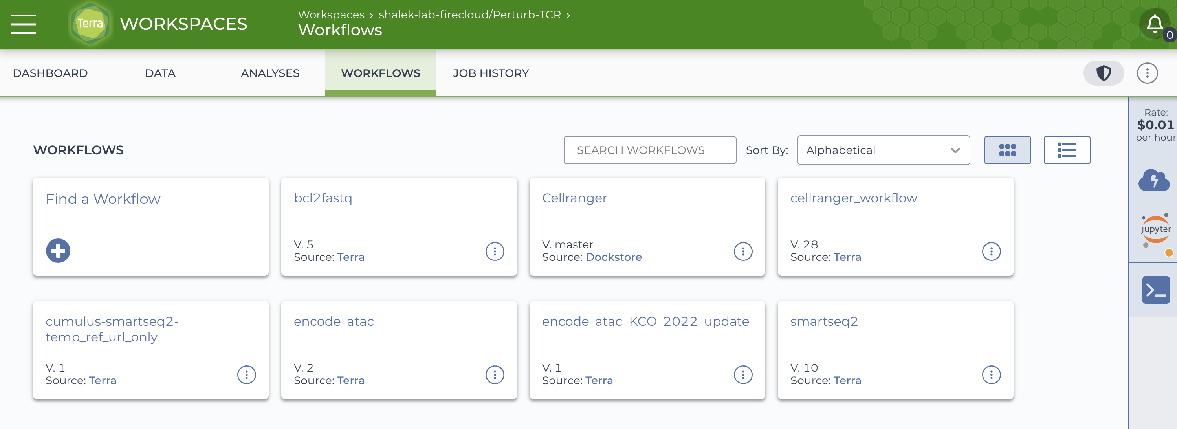
Add Cumulus “Cellranger” workflow to Terra workspace

Slide 24
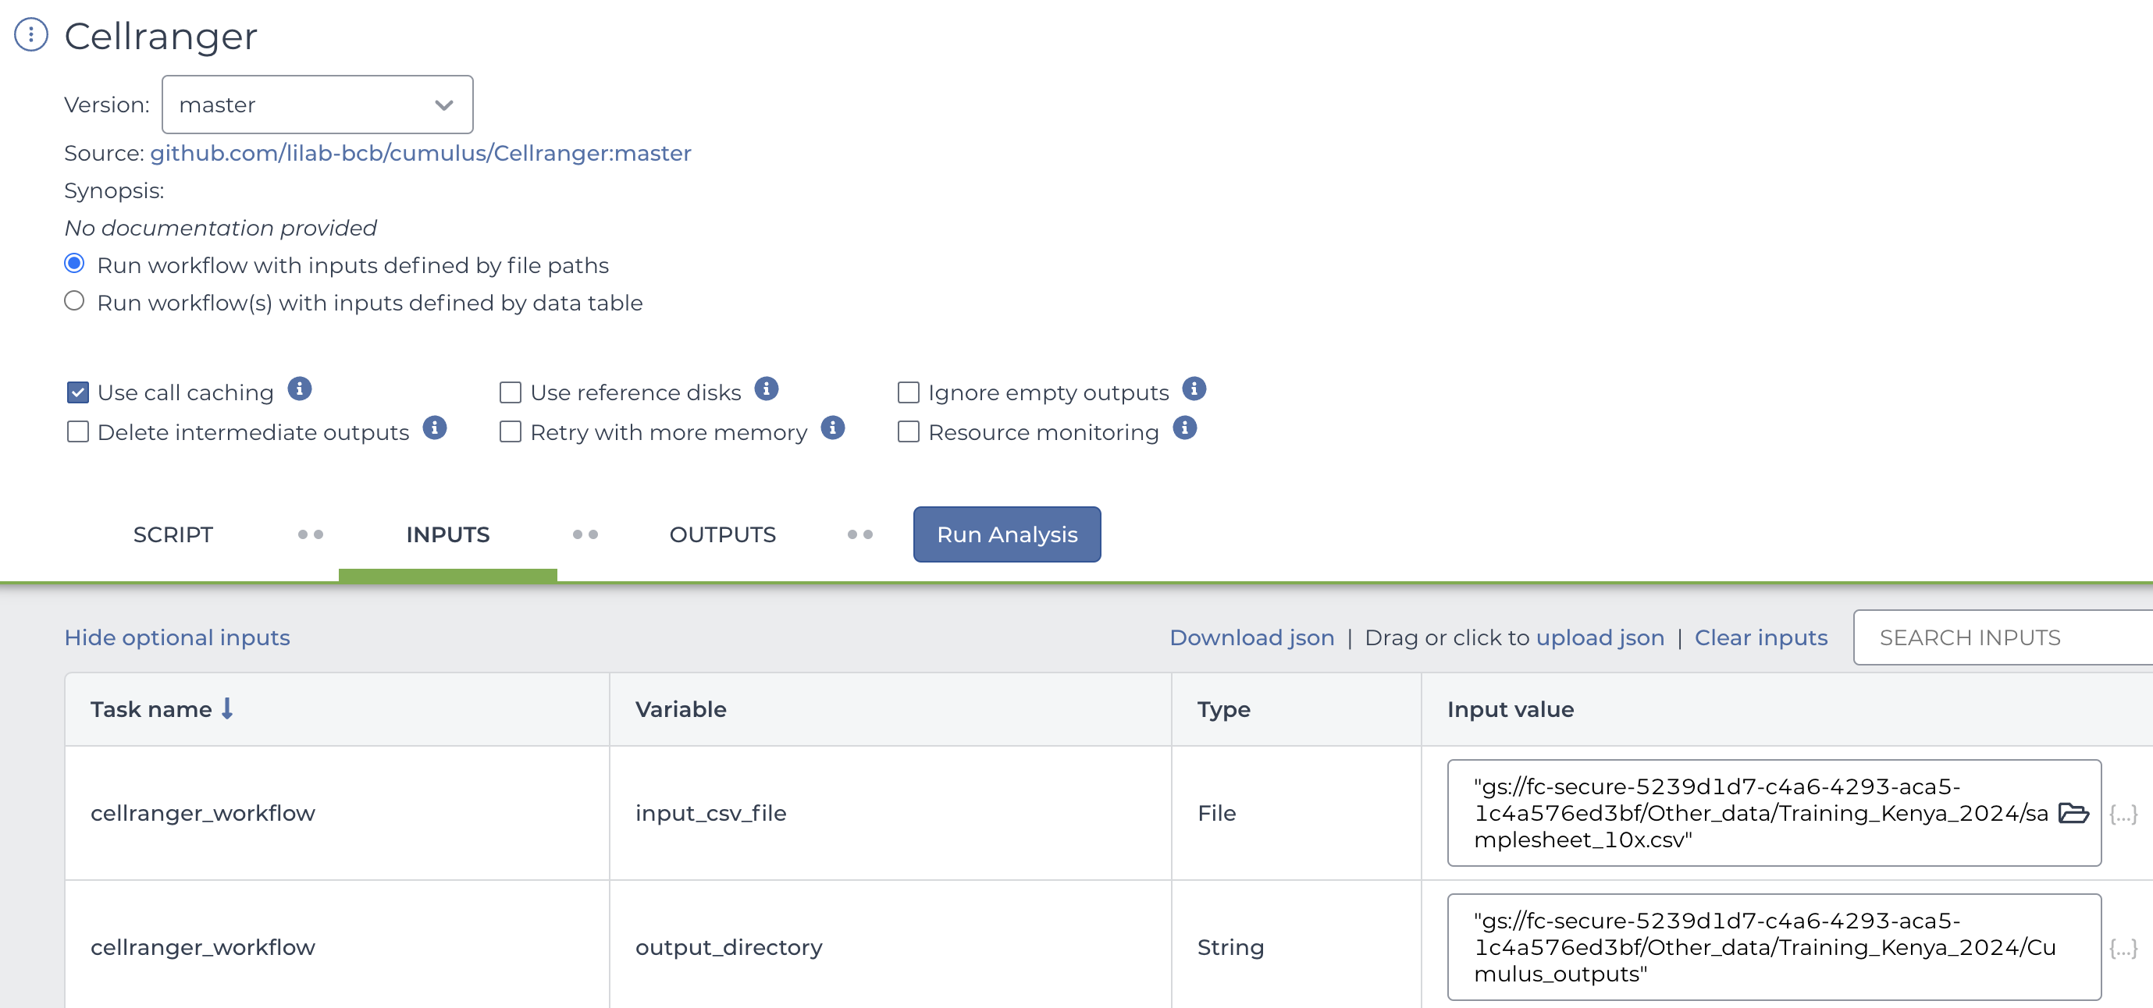
Run Cumulus Cell Ranger workflow

Slide 25
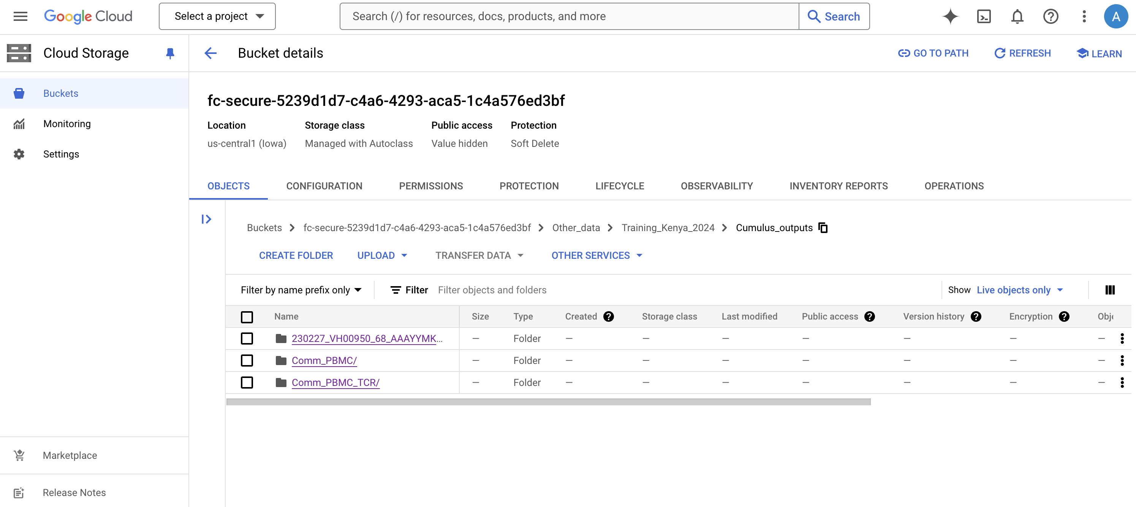
When workflow completes, data is found in Google bucket

Slide 26
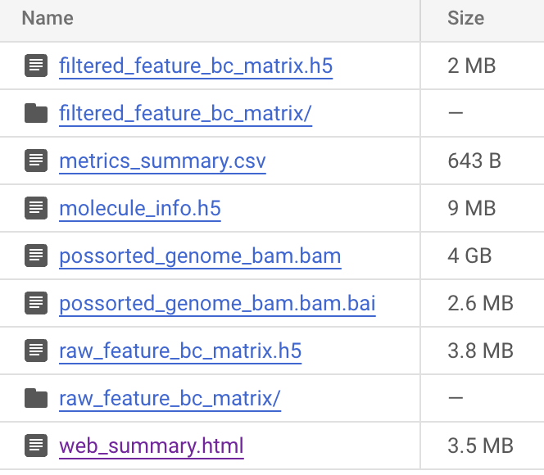
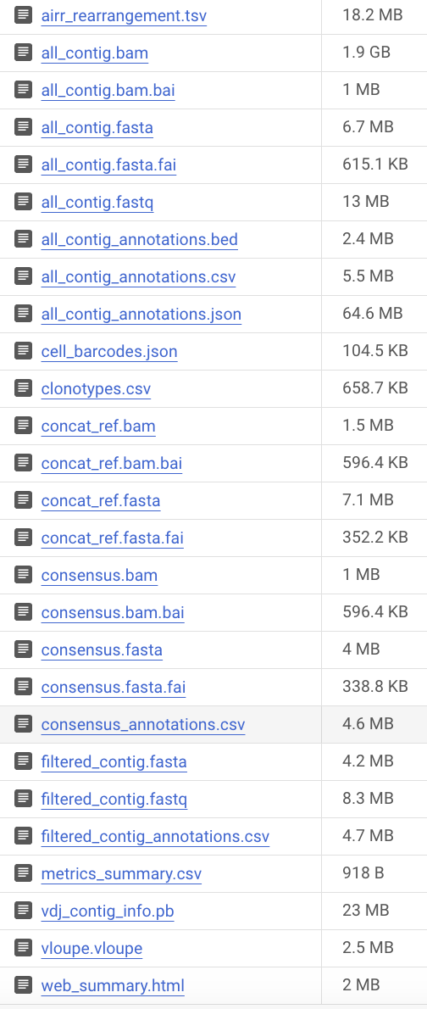
Confirm workflow outputs
Gene expression outputs
TCR outputs

Slide 27
Next steps
Downstream analysis
Quality control and normalization
Cell type annotation
Differential expression
Batch correction and dataset integration
Immune repertoire (TCR/BCR) characterization
More resources for getting started with Terra
Intro to Terra slides: https://broad.io/T101-PDF
Terra videos on YouTube: https://www.youtube.com/@TerraBioApp
Terra support site: https://support.terra.bio/hc/en-us/sections/23504885621787

